Slide 1
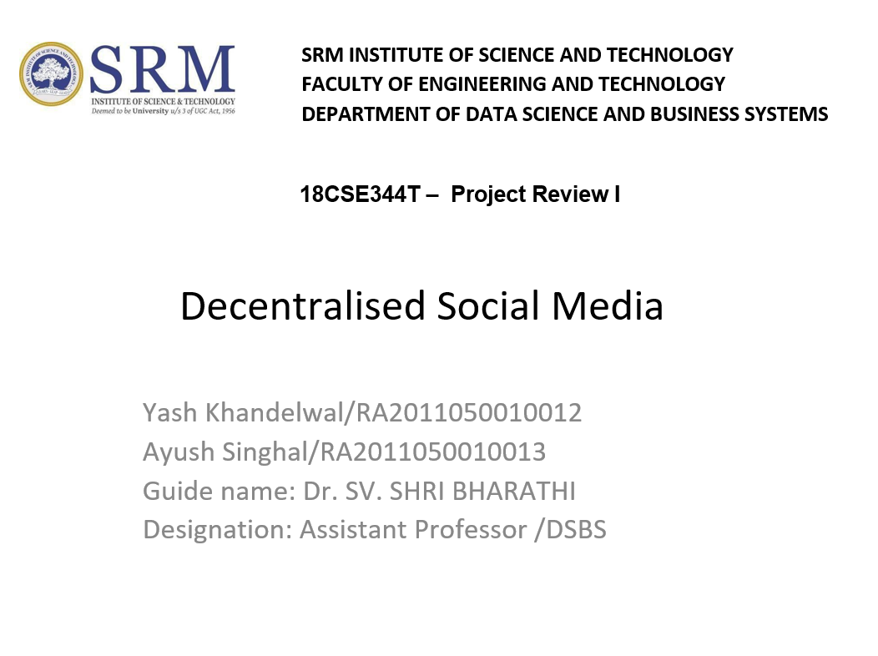

Slide 2
Table of contents 1. Introduction 2. Abstract 3. Objective 4. Tool used 5. Explanation about the tool 6. Algorithm 7. Architecture diagram 8. Description of algorithm 9. Modules 10. Experimental Results 11. Output Screen Shots 12. Coding 13. Reference Papers

Slide 3
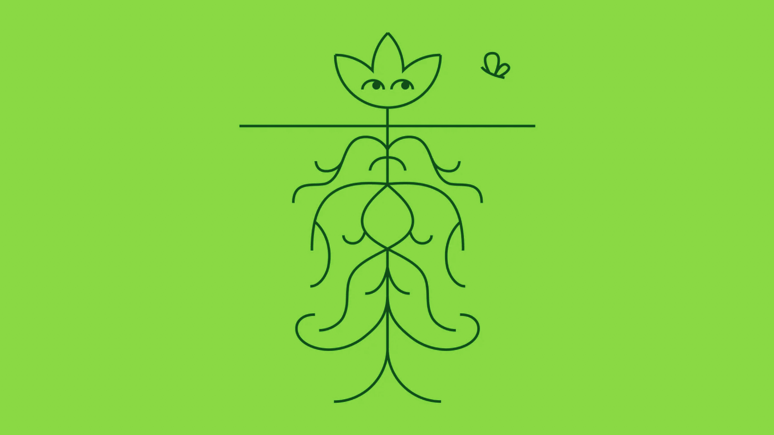
Decentralised Social Media

Slide 4
Introduction
The purpose of the Lens Protocol is to empower creators to own the links between themselves and their community, forming a fully composable, decentralized social graph. This is achieved by allowing users to create profiles and interact with each other via these profiles. "Profile" (as used here) refers specifically to Lens profiles; "user" refers to standard crypto-wallets.

Slide 5
Abstract
Social media is undeniably popular. With digital platforms to share ideas, content and information, communities are built and individuals are given a space to have their voices heard in ways never experienced before. It’s an exciting, lucrative environment for content sharing and community building. This digital space is here. And it’s here to stay.

Slide 6
Objective
Decentralized social media is the most appropriate answer to the monopolistic attitudes of modern social networking platforms. You cannot make billions of Facebook users close their accounts and switch to a new social networking platform just like that. You have to provide them with a better alternate solution, and that’s what decentralized social media aims to achieve.

Slide 7
Tool Used
The Lens Protocol is a smart contracts-based social graph built on top of the Polygon blockchain, built by the team that created Aave. Since Polygon uses a Proof-of-Stake consensus algorithm, it is energy-efficient and affordable.

Slide 8
How Lens Protocol works
Lens Protocol’s social chart is established through a graph database (GDB). These databases use graph systems that contain individual nodes, and advantages such as connection issues between them, places, objects, and other effects to store data. These charts show the components of the network and the connections between them.

Slide 9
Algorithm
GRAPH –
The graph is an Indexing protocol for querying blockchain data with GraphQL. It helps in structuring and organizing open data and makes it easily accessible for decentralized applications. Think of blockchain as a book and graph as the index page . Without the index , it will be difficult to find a particular useful chapter or a page that you are looking for in the book.
Consensus Mechanism -
Proof of Stake

Slide 10
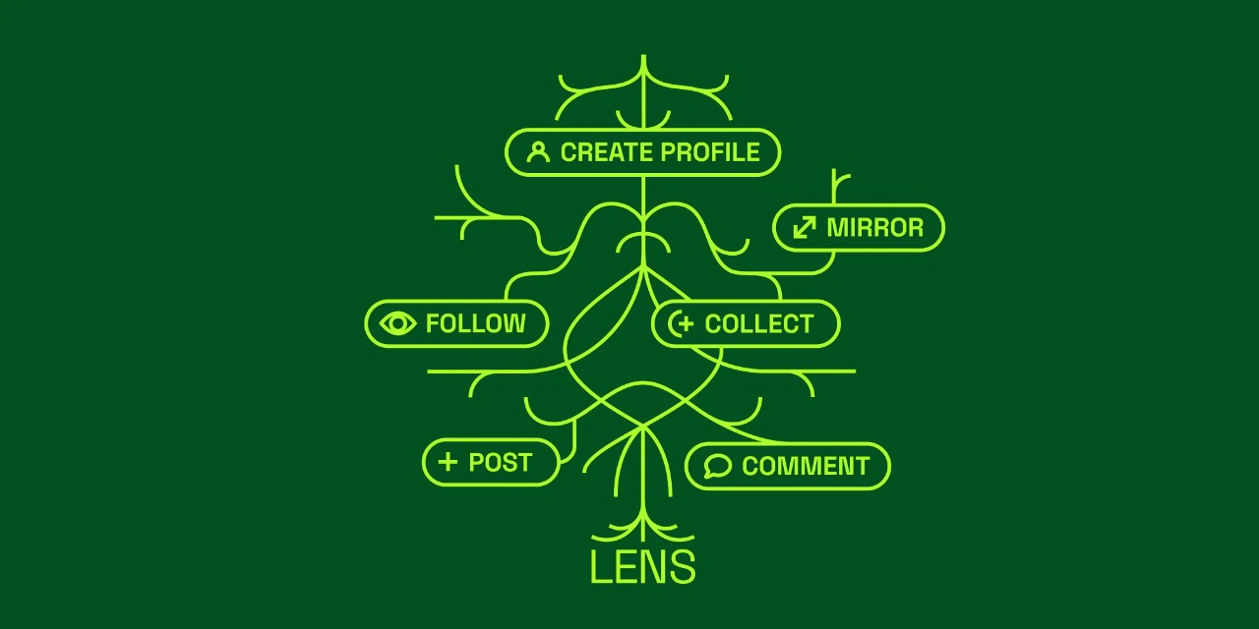
Architecture Design
Lens Profile architecture

Slide 11
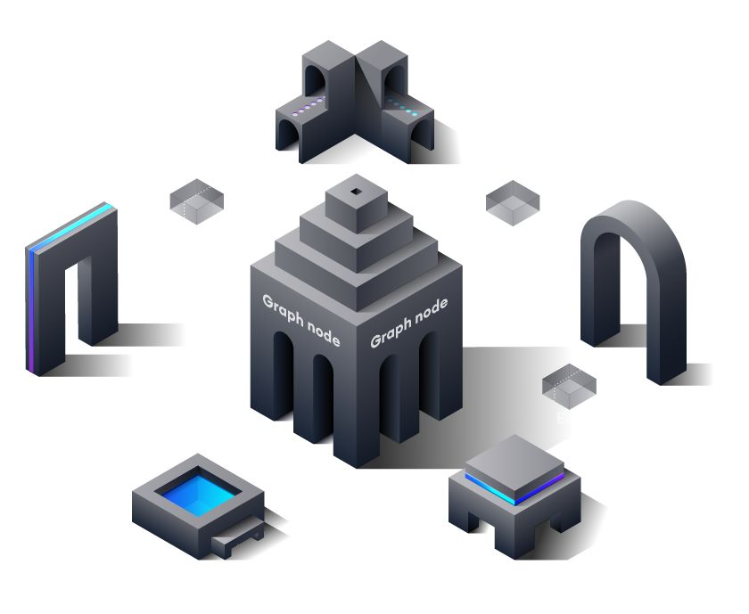
Profile storage in graph

Slide 12
Description of algorithm
The Graph is an indexing protocol for querying networks like Ethereum and IPFS. Anyone can build and publish open APIs, called subgraphs, making data easily accessible. Subgraphs can be composed into a global graph of all the world's public information. This data can be transformed, organized, and shared across applications for anyone to query with just a few keystrokes.

Slide 13
Modules
CollectNFT.sol - Move royalties setup from proxy constructor to clone initializer
.eslintrc.json - Initial commit
solcover.js - Added tests for zero treasury fee on referral.
docker-entrypoint.sh - Small compose fixes

Slide 14
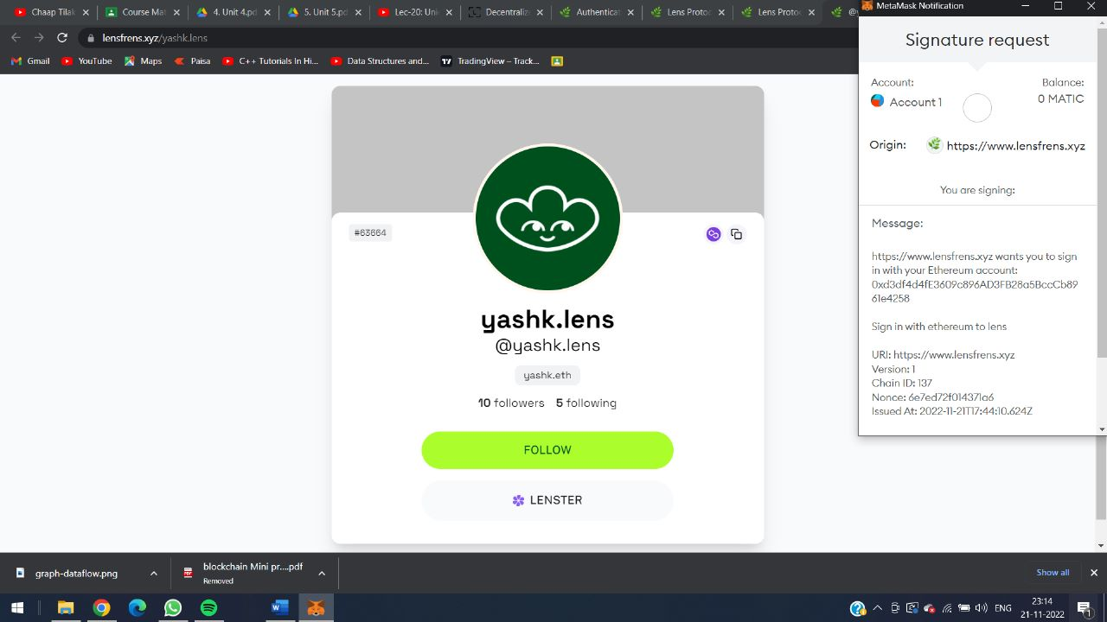

Slide 15
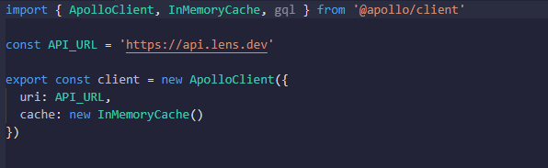
Create a file named api.js in the root of the project and add the following code:

Slide 16
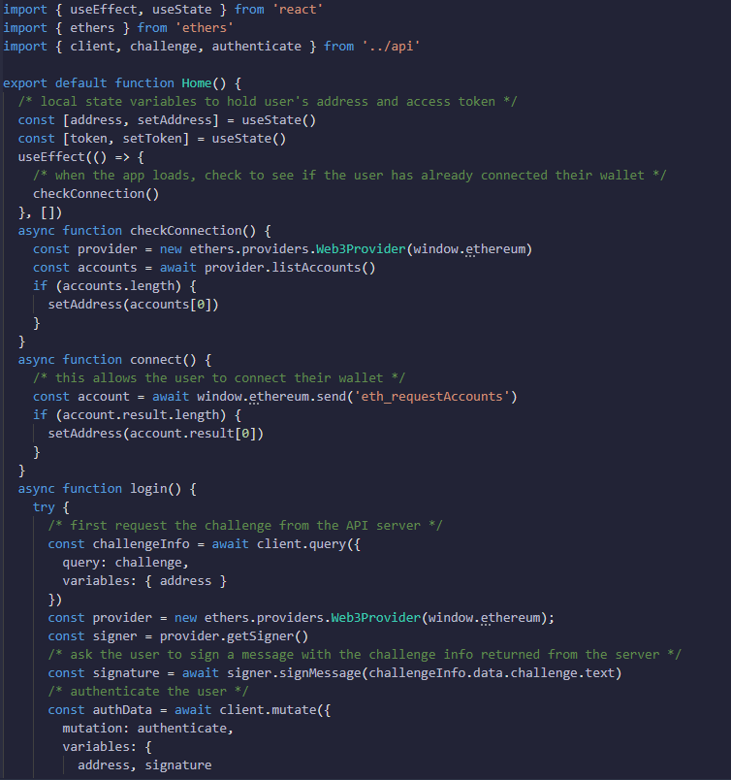
Building the authentication flow Now that the GraphQL client is configured, let's build out the authentication flow. Update index.js with the following code:

Slide 17
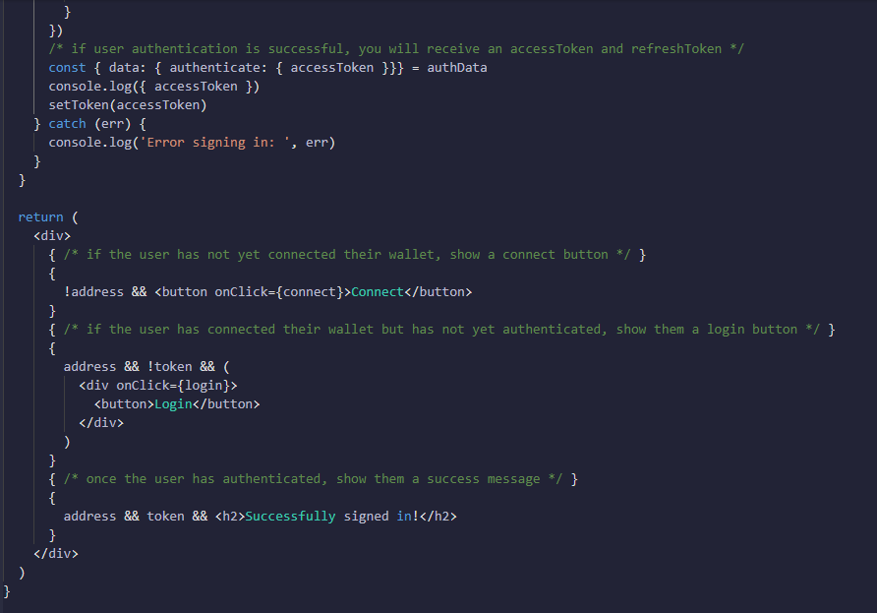
Continued…

Slide 18
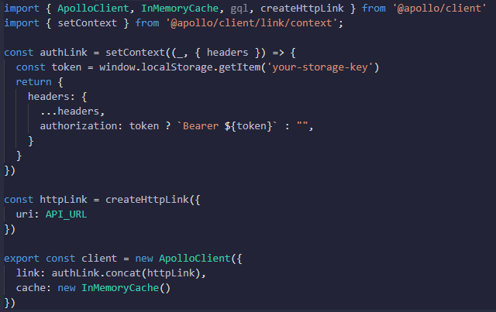
Apollo Link You can also consider using Apollo Link to automatically add an authorization header to every HTTP request. This would change the way you configure your client:

Slide 19
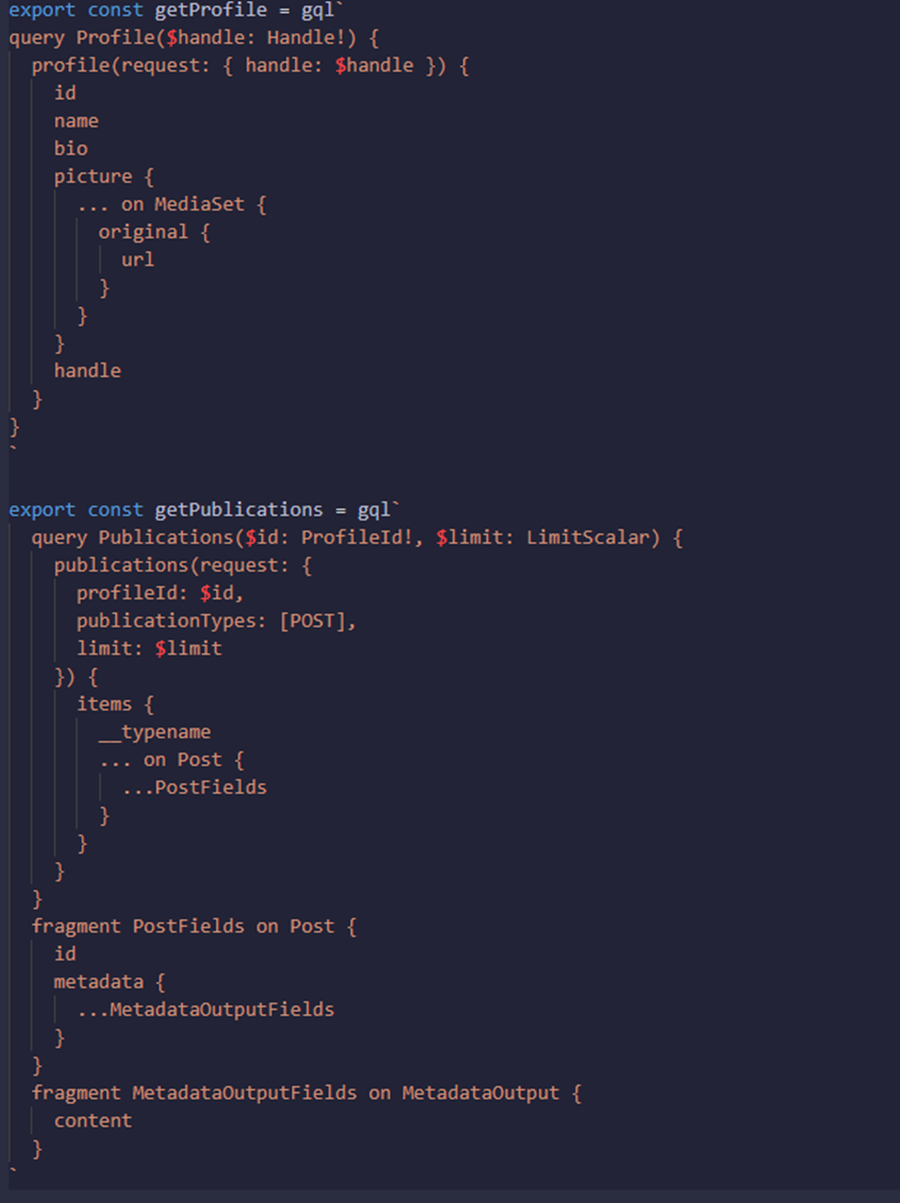
Viewing an individual profile

Slide 20
Reference Paper
https://www.lens.xyz/
https://phemex.com/academy/what-is-decentralized-social-media
https://www.sciencedirect.com/topics/engineering/blockchain#:~:text=Abstract,that%20are%20digitized%20and%20decentralized.
https://aws.amazon.com/blockchain/decentralization-in-blockchain/
https://docs.lens.xyz/docs/authentication-quickstart

Slide 21
Thank You
Made by –
Yash Khandelwal (RA2011050010012)
Ayush Singhal (RA2011050010013)

